Slide 2
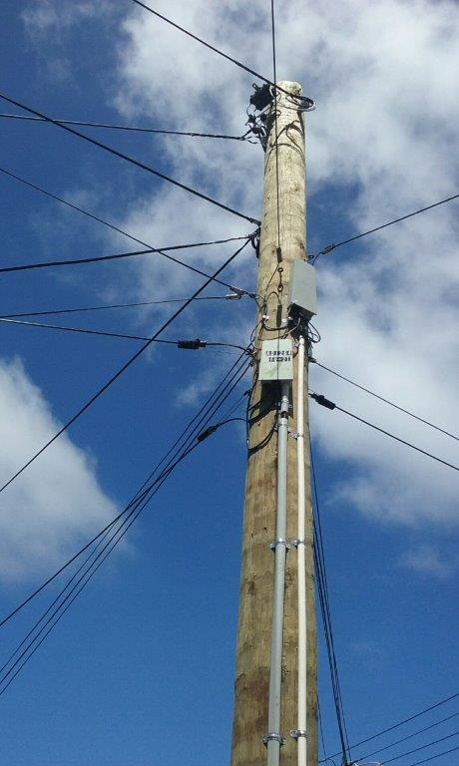
Pole Prediction Project
We test every pole every year. We know roughly the length of the life of a pole. ​
​
We could save a large amount of money and time by applying machine learning predictive maintenance to pole testing.​
​
We know that some portion of the data here is questionable. ​
​
Is the data quality good enough to support a machine learning model to save us money and time?​
​
How much could the model save us? How much more could we save with better data quality?​

Slide 3
Pole Classification Project
We test every pole every year. We know roughly the length of the life of a pole. ​
We have a layered testing process that triages poles initially by visual inspection with additional vonaq testing for a subset of wooden poles. “Yellow” poles will be re-inspected according to a specified schedule then regraded accordingly.
We could save money by deferring testing.​ However, if we defer testing for the wrong poles, we incur risk of pole failure. The downstream risks (e.g. public safety, service disruption) can vary by locality (urban, rural, etc.) and other factors.
Can finer grain than “Yellow” be found that allows longer deferral of testing in some cases? That is, can we identify clusters that identify poles at statistically different stages of asset degradation?
We know that some portion of the data here is questionable. ​
Is the data quality good enough to identify meaningful rules to save us money and time?​
How much could this save us? How much more could we save with better data quality?​

Slide 4
Why using ML in predictive maintenance
Predictive maintenance doesn’t need to require anything more than an informal mathematical computation.
ML eliminates most of the guesswork and can help us focus on other tasks as it enables us to:
Create predictive models for maximizing assets lifetime, operational efficiency and or uptime
Leverage past data and or continuous data
Optimise the periodic maintenance operations
Avoid or minimise downtimes saving money, time and frustration
However, success in using ML for Predictive Maintenance requires:​
Having the right data available relevant, sufficient, quality​
Framing the problem appropriately including feature engineering​
Evaluating the model predictions properly
Notes:
semi-manual approach doesn’t take into account the more complex dynamic behavioral patterns of the machinery, or the contextual data relating to the manufacturing process at large.
In contrast, ML algorithms are fed OT data (from the production floor: sensors, PLCs, historians, SCADA), IT data (contextual data: ERP, quality, MES, etc.), and manufacturing process information describing the synchronicity between the machines, and the rate of production flow.
In industrial AI, the process known as “training”, enables the ML algorithms to detect anomalies and test correlations while searching for patterns across the various data feeds.

Slide 5
What have we found makes a successful ML project?
What Problem are you trying to solve?
Is it better than what we’ve got?
When the business is super clear about
What they want
How they will use it/embed it when its completed
Where the prediction can be an easy y/n
Where the business has or is willing to help create training data set
Where we believe the preliminary model or models
Where we can learn things even if the model doesn’t work
Sample Sizing – what’s the size of the population that you want to model
Right size the solution
Notes:
Pause and ask :What should the order of this be?
Also on here should be Data infrastructure

Slide 6
Pole Data sources
There are a number of tables in Netmap that store poles inspection and testing data. Basically however, there are three main datasets:
Table | General Description | Natural Key
CHORUS_POLE | Records all poles, owner, position, serial number, year of manufacture, specification, whether decommissioned and some other information. | ID (unique pole identifier)
CHORUS_POLE_INSPECTION | Details of physical pole inspections, aspects of physical tests and observations, inspection results. | CHORUS_POLE_ID (foreign key to CHORUS_POLE.ID) and TIMESTAMP
CHORUS_VONAQ_TEST | Details of Vonaq tests, if performed, for each pole. Although this is planned, it currently lacks a foreign key to CHORUS_POLE_INSPECTION. This means that it is not easily feasible to join the CHORUS_POLE_INSPECTION table to CHORUS_VONAQ_TEST. | CHORUS_POLE_ID (foreign key to CHORUS_POLE.ID) and in principle, MEASURE_DATE. But MEASURE_DATE has many nulls. Foreign key CHORUS_POLE_INSPECTION_ID exists but is not yet populated, therefore of no use.

Slide 7
Data issues
Here is a by no means exhaustive list of issues with the three tables mentioned.
There are some outlier values in the CHORUS_POLE data that probably ought to be cleaned:
There are many rows with null decommission reason when the decommission date is populated.
DATE_TIME: The name doesn’t help much. We don’t know what this means.
There are duplicates in the CHORUS_POLE_INSPECTION and CHORUS_VONAQ_TEST tables. No referential integrity seems to be enforced.
Column datatypes are inappropriate for the kinds of data being stored, for example CHORUS_VONAQ_TEST.MEASURE_DATE is varchar2, whereas it should probably be a date or timestamp. Entry validation doesn’t seem to have occurred.
Although the tables all have synthetic primary keys, the natural keys to which they correspond are defective, e.g. MEASURE_DATE can be null. This should not happen, though it may be imposed by system constraints elsewhere. This renders a lot of data essentially useless.
There are many nulls in many fields in both Pole_Inspection and Vonaq_Test data (especially the latter). Is this due to lack of enforcement on entry? What does it mean?
About 260 records in the CHORUS_VONAQ_TEST table have no matching chorus_pole_id in the CHORUS_POLE table.
The foreign key in the vonaq table joining to the pole inspection table is null. This make analysis very problematic (which vonaq tests relate to which inspections? There is no reliable way to join these tables unless this key is populated.)

Slide 8
Data issues continued
The poles table has a number poles dating from around the birth of Christ, some from just after the Norman Conquest, and a number from the future. Also, the year_of_manufacture is null in about 74% of the entries:

Slide 9
Poles Table Columns Stats
Column excluded=‘Yes’ marks fields with inconsistent datatype, excluded from the analysis

Slide 10
Pole Inspections Table Columns Stats

Slide 11
Vonaq Tests Table Columns Stats (page 1)

Slide 12
Vonaq Tests Table Columns Stats (page 2)

Slide 13
11722
Analysis of Poles Inspection data with all non-null entries
This limits our consideration of features only to those that show no nulls in the available data. Also considering only Softwood(new), Softwoord (old), and Hardwood
4 target clusters on “Yellow” visual inspections only
Cluster Sizes
Cluster 0: 11722 cases
Cluster 1: 2080 cases
Cluster 2: 5007 cases
Cluster 3: 7595 cases
Probably too many clusters
2 target clusters on “Yellow” visual inspections only
Cluster Sizes
Cluster 0: 21276 cases
Cluster 1: 5128 cases
3 target clusters on “Red” and “Yellow” visual inspections only
Cluster Sizes
Cluster 0: 9440 cases
Cluster 1: 16982 cases
Cluster 2: 14265 cases
3 target clusters on “Yellow” and “Green” visual inspections only
Cluster Sizes
Cluster 0: 32067 cases
Cluster 1: 30039 cases
Cluster 2: 31589 cases
6 target clusters on all visual inspections
Cluster Sizes
Cluster 0: 19701 cases
Cluster 1: 21061 cases
Cluster 2: 9231 cases
Cluster 3: 16042 cases
Cluster 4: 12275 cases
Cluster 5: 29668 cases
4 target clusters on all visual inspections
Cluster Sizes
Cluster 0: 32427 cases
Cluster 1: 13693 cases
Cluster 2: 31932 cases
Cluster 3: 29926 cases

Slide 14
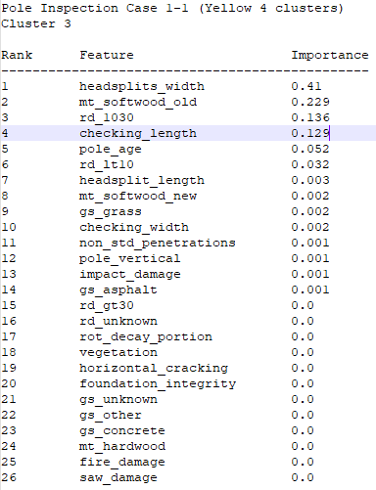
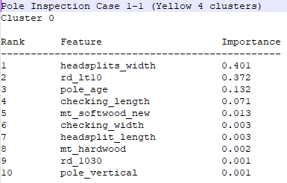
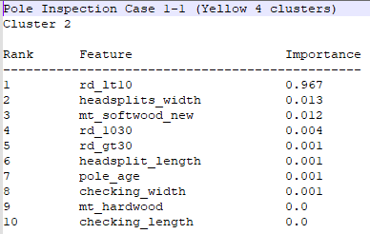
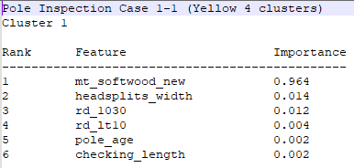
Pole Inspection data (Yellow 4 clusters) most important features distinguishing each cluster

Slide 15
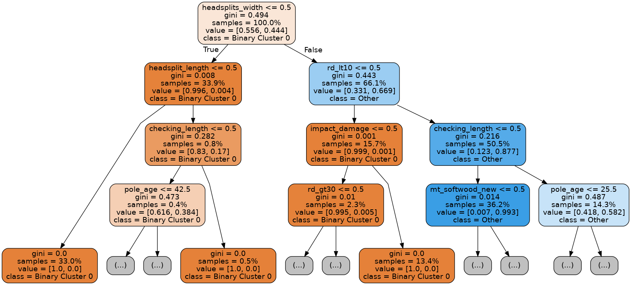
Pole Inspection Case 1-1 (Yellow 4 clusters) Cluster 0

Slide 16
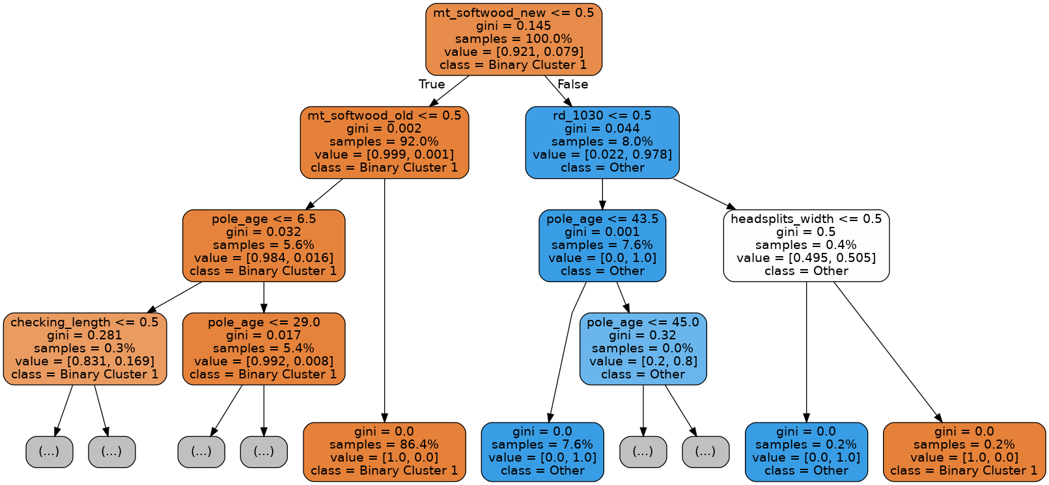
Pole Inspection Case 1-1 (Yellow 4 clusters) Cluster 1

Slide 17
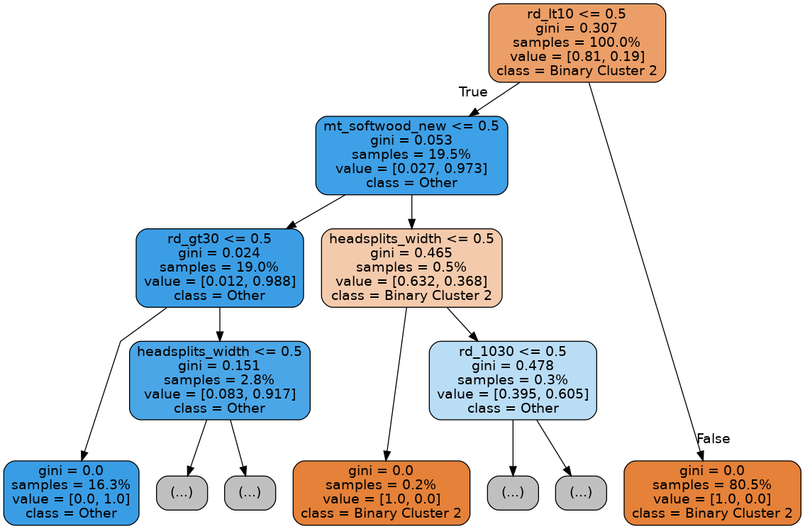
Pole Inspection Case 1-1 (Yellow 4 clusters) Cluster 2
Notes:
Note that RHS from root node is nearly identical to the Cluster 3 case.

Slide 18
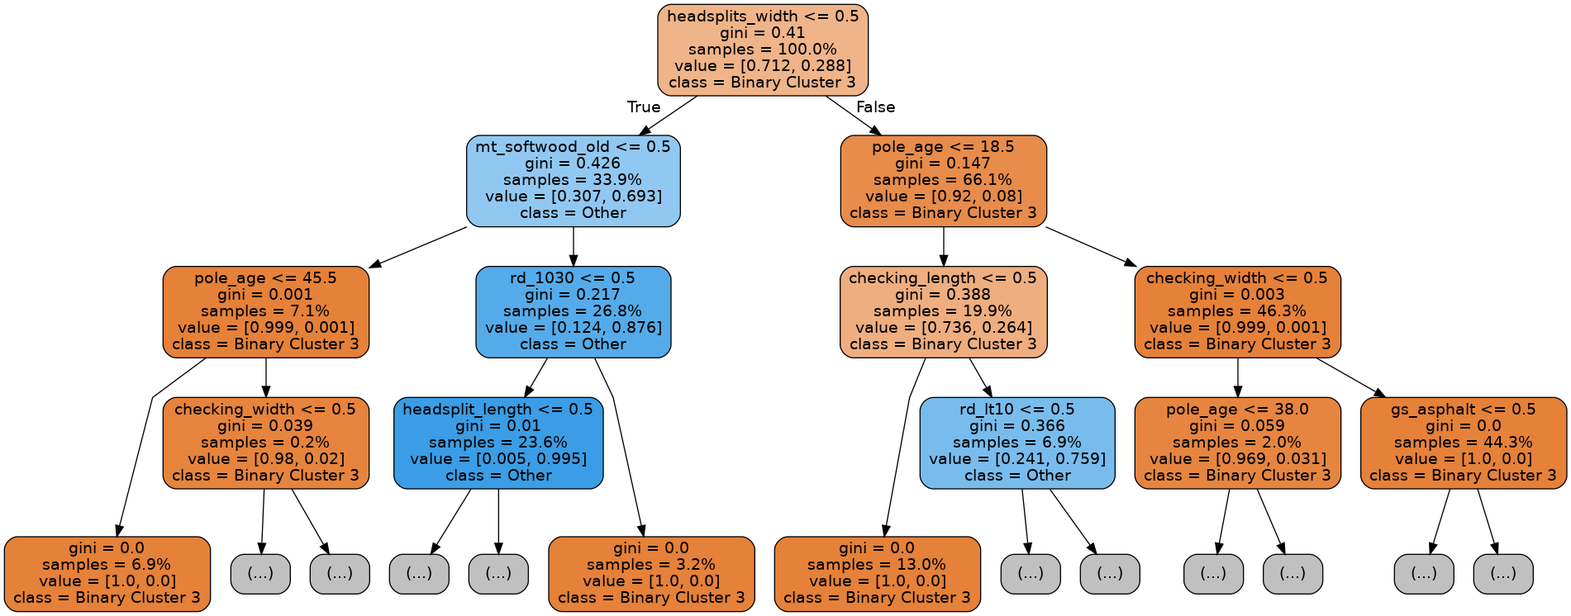
Pole Inspection Case 1-1 (Yellow 4 clusters) Cluster 3

Slide 19
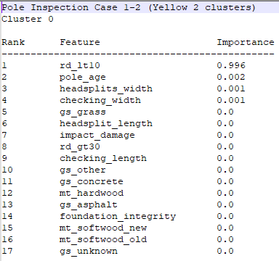
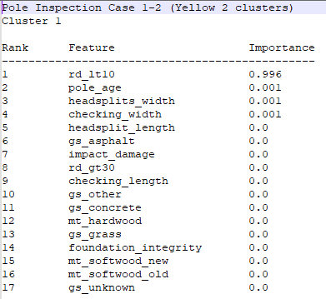
Pole Inspection data (Yellow 2 clusters) most important features distinguishing each cluster

Slide 20
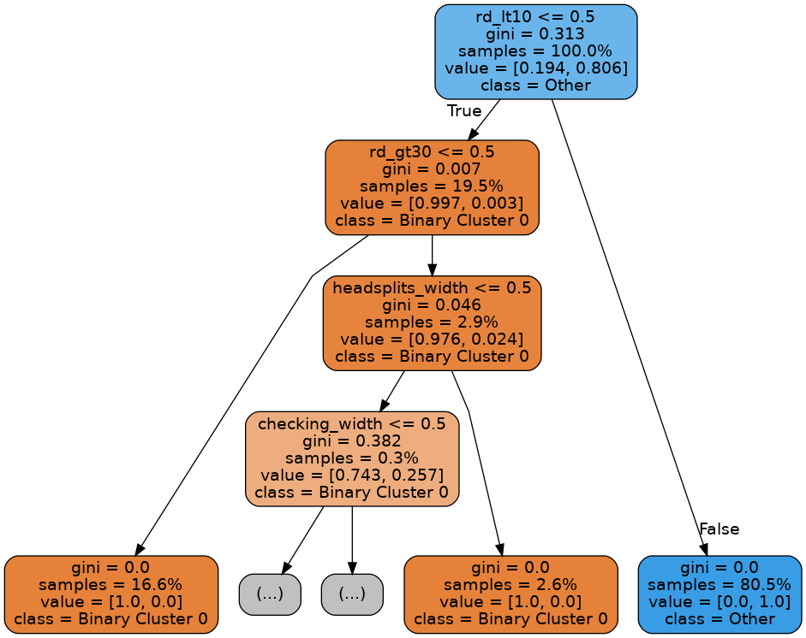
Pole Inspection Case 1-2 (Yellow 2 clusters) Cluster 0

Slide 21
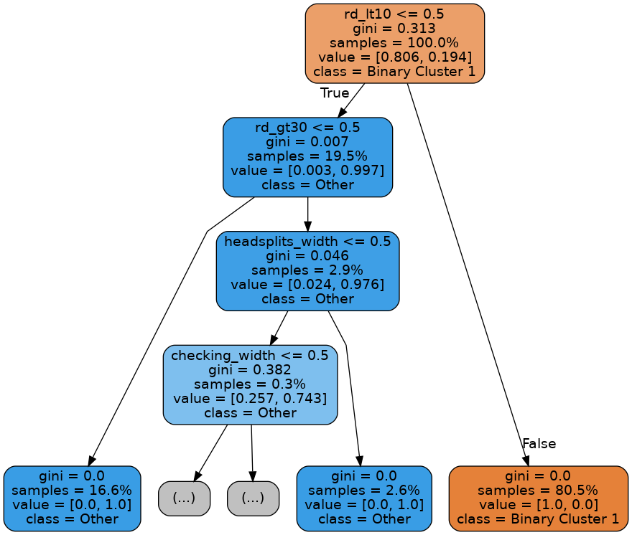
Pole Inspection Case 1-2 (Yellow 2 clusters) Cluster 1

Slide 22
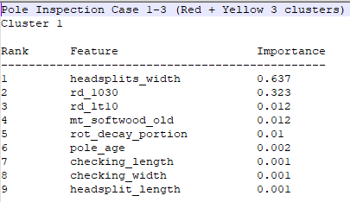
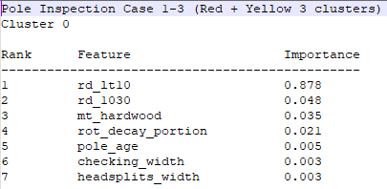
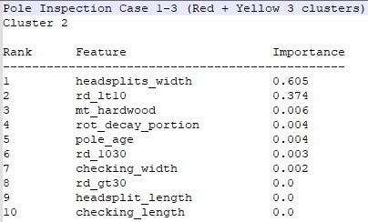
Pole Inspection Case 1-3 (Red +Yellow 3 clusters) most important features distinguishing each cluster

Slide 23
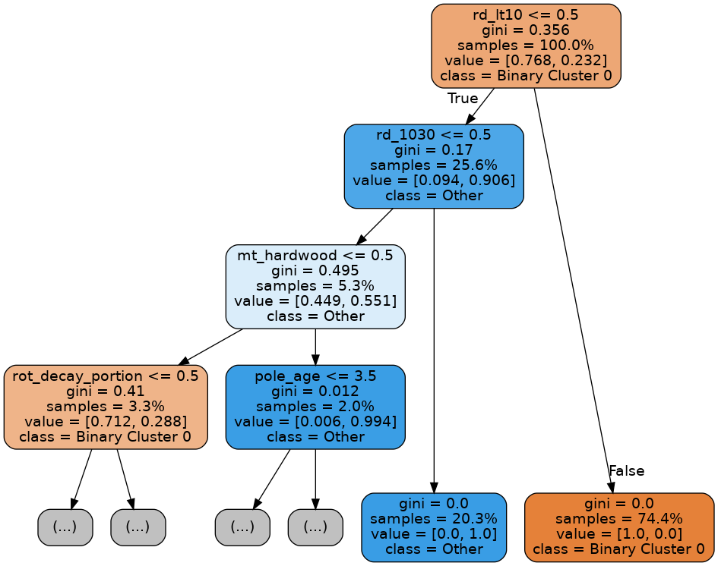
Pole Inspection Case 1-3 (Red + Yellow 3 clusters) Cluster 0

Slide 24
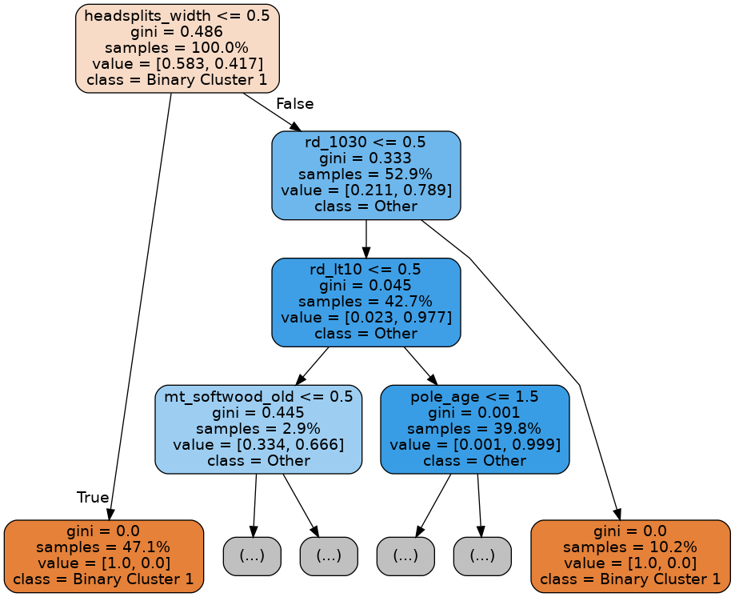
Pole Inspection Case 1-3 (Red + Yellow 3 clusters) Cluster 1

Slide 25
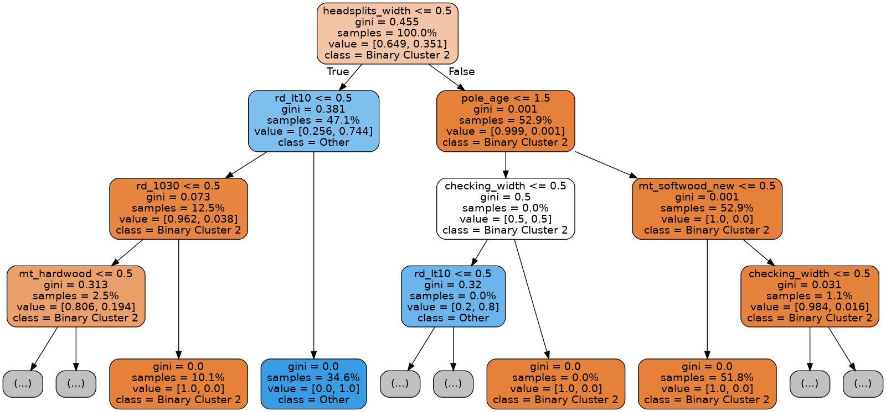
Pole Inspection Case 1-3 (Red + Yellow 3 clusters) Cluster 2

Slide 26
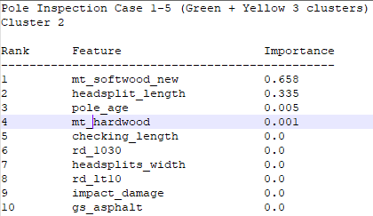
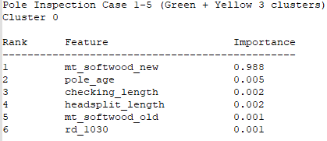
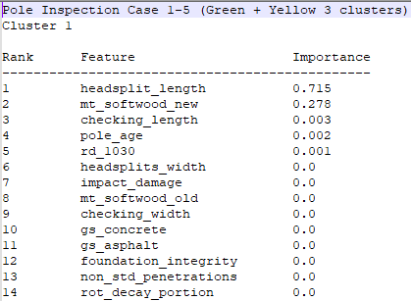
Pole Inspection Case 1-5 (Red +Green 3 clusters) most important features distinguishing each cluster

Slide 27
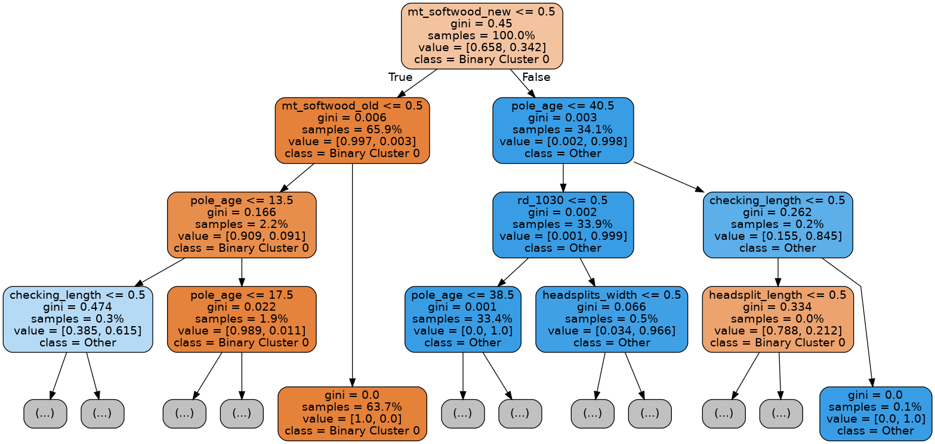
Pole Inspection Case 1-5 (Red + Green 3 clusters) Cluster 0

Slide 28
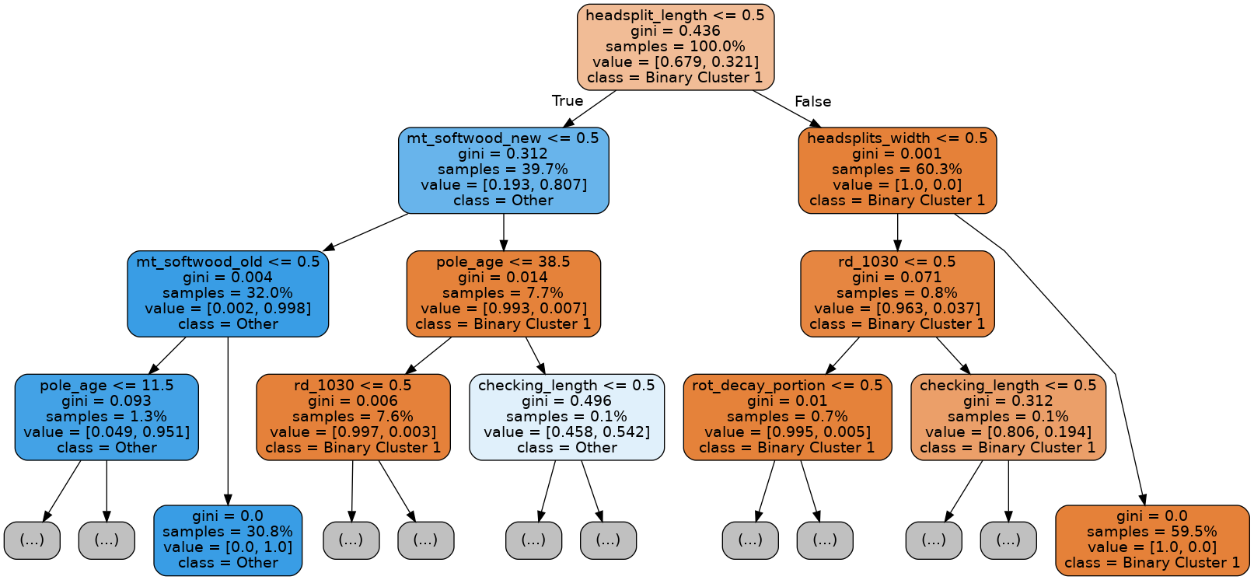
Pole Inspection Case 1-5 (Red + Green 3 clusters) Cluster 1

Slide 29
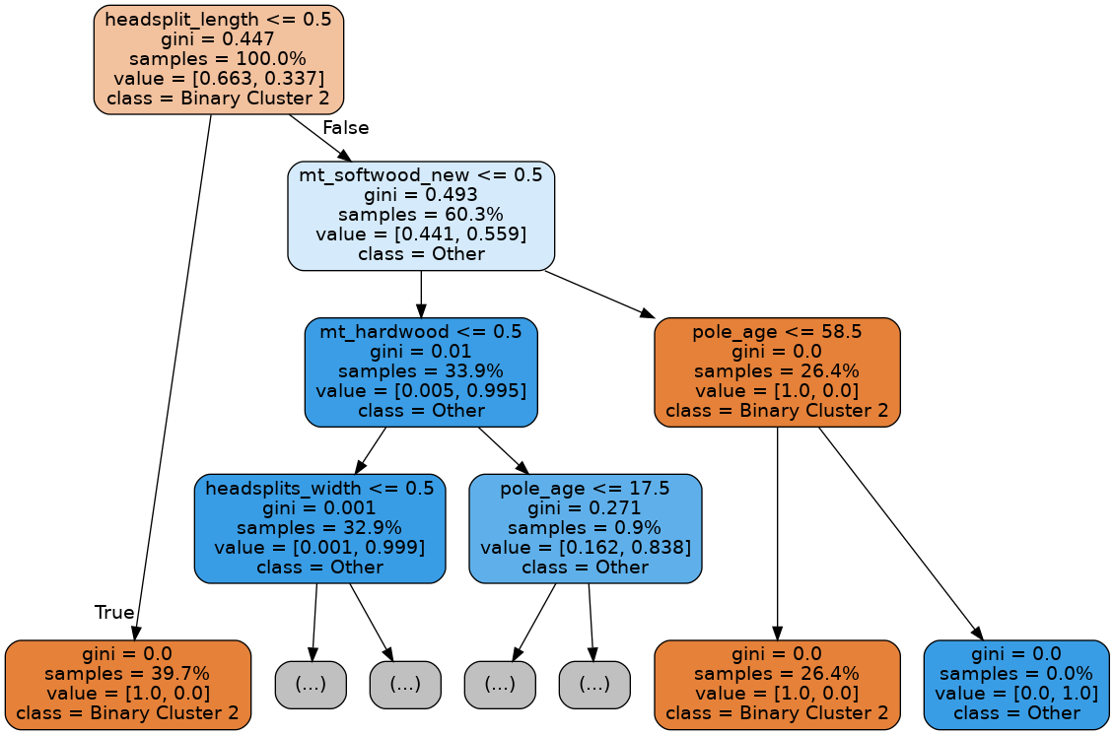
Pole Inspection Case 1-5 (Red + Green 3 clusters) Cluster 2

Slide 30
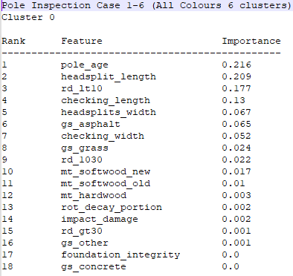
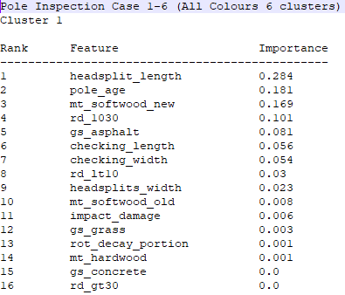
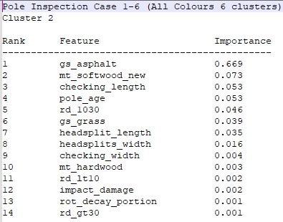
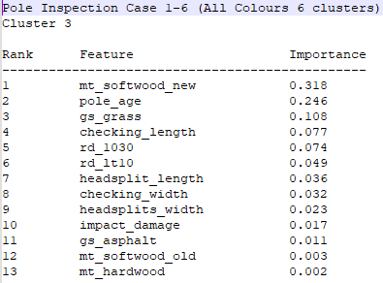
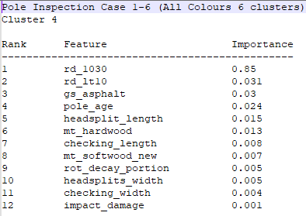
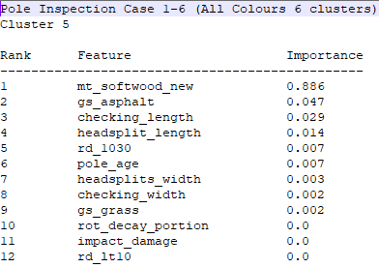
Pole Inspection Case 1-6 (All Colours 6 clusters) most important features distinguishing each cluster

Slide 31
Analysis of Vonaq Test data
Excluding cases where and we exclude cases where pole_age is null
Case 2-0: 4 target clusters on “Yellow” vonaq tests only
Cluster Sizes
Cluster 0: 1517 cases
Cluster 1: 2859 cases
Cluster 2: 1053 cases
Cluster 3: 2324 cases
Case 2-1: 4 target clusters all colours vonaq tests only
Cluster Sizes
Cluster 0: 32547 cases
Cluster 1: 31946 cases
Cluster 2: 58732 cases
Cluster 3: 26909 cases
Case 2-2: 3 target clusters “Yellow”vonaq tests only
Cluster Sizes
Cluster 0: 2660 cases
Cluster 1: 2041 cases
Cluster 2: 3052 cases
Case 2-3: 4 target clusters on “Red” and “Yellow” vonaq tests only
Cluster Sizes
Cluster 0: 1532 cases
Cluster 1: 4484 cases
Cluster 2: 3030 cases
Cluster 3: 4793 cases
Case 2-4 4 target clusters on”Green” and “Yellow” vonaq tests only
Cluster Sizes
Cluster 0: 31130 cases
Cluster 1: 30693 cases
Cluster 2: 25988 cases
Cluster 3: 56238 cases

Slide 32
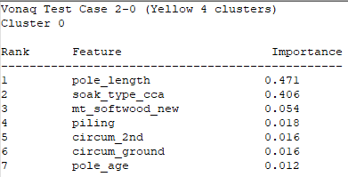
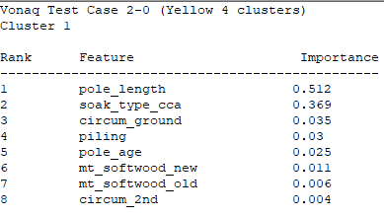
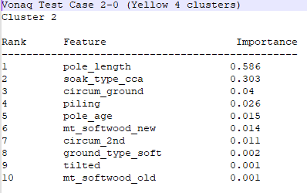
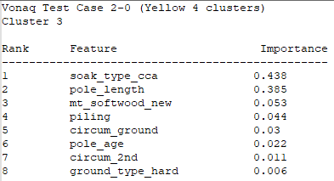
Vonaq Test data Case 2-0 (Yellow 4 clusters) most important features distinguishing each cluster

Slide 33
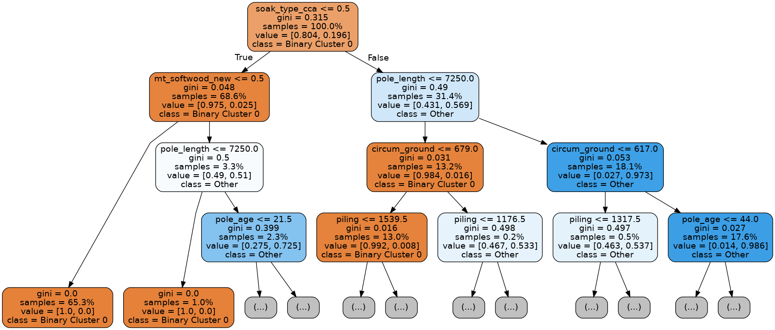
Vonaq Test data Case 2-1 (Yellow 4 clusters) Cluster 0
Notes:
When soak_type is not unknown then Cluster 0
When soak_type = unknown and pole_length > 7250 the Cluster 0

Slide 34
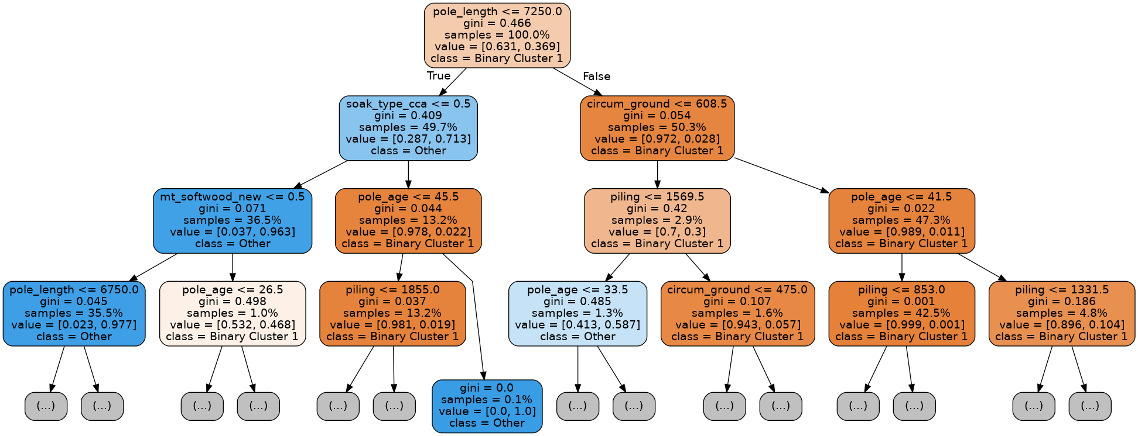
Vonaq Test data Case 2-0 (Yellow 4 clusters) Cluster 1

Slide 35
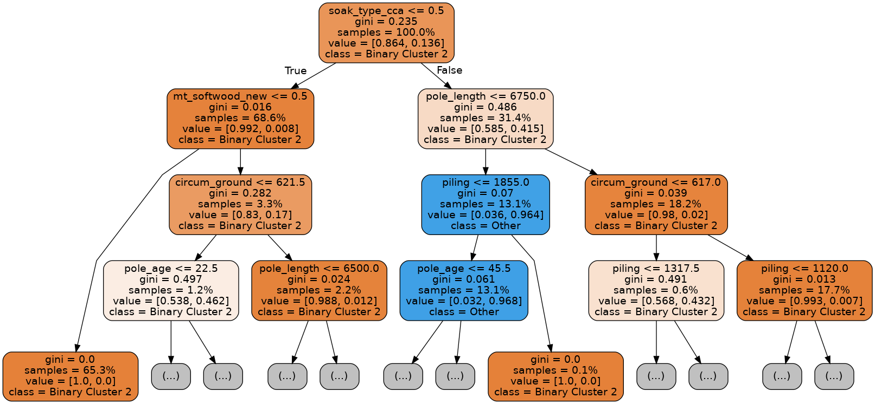
Vonaq Test data Case 2-0 (Yellow 4 clusters) Cluster 2

Slide 36
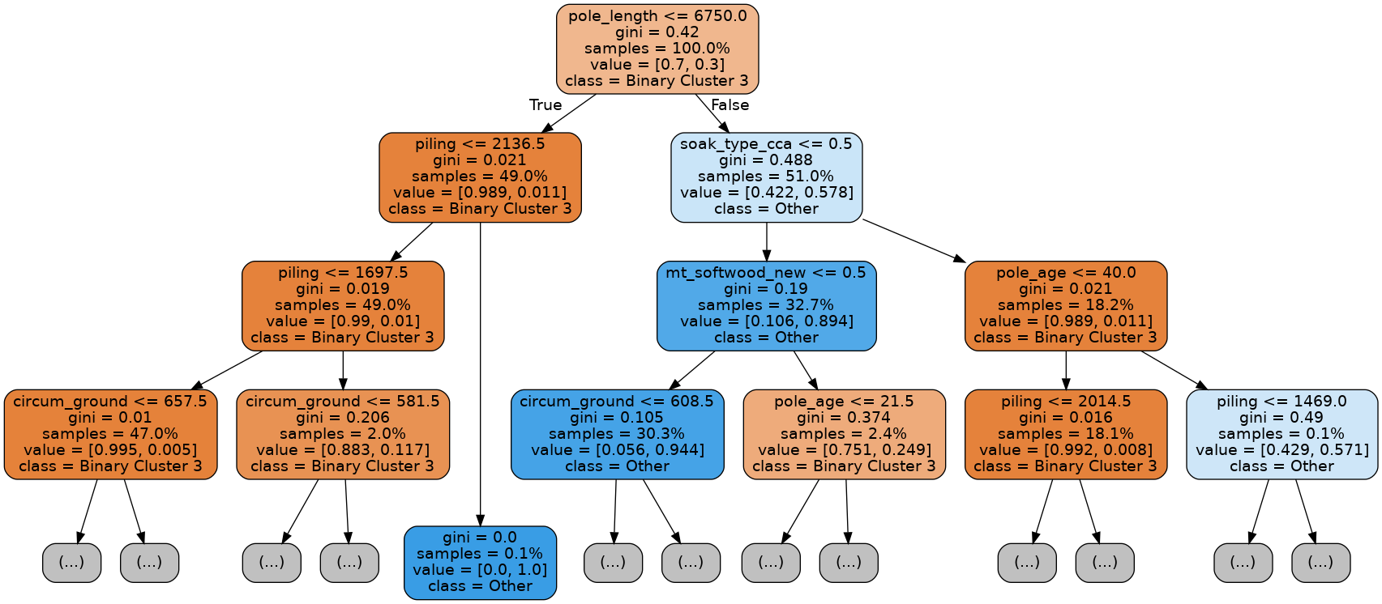
Vonaq Test data Case 2-0 (Yellow 4 clusters) Cluster 3

Slide 37
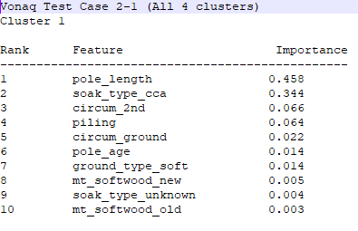
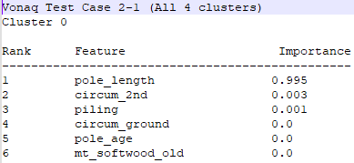
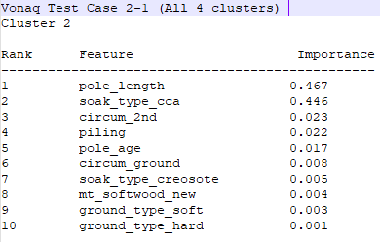
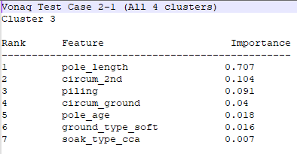
Vonaq Test data Case 2-1 (All colours 4 clusters) most important features distinguishing each cluster

Slide 38
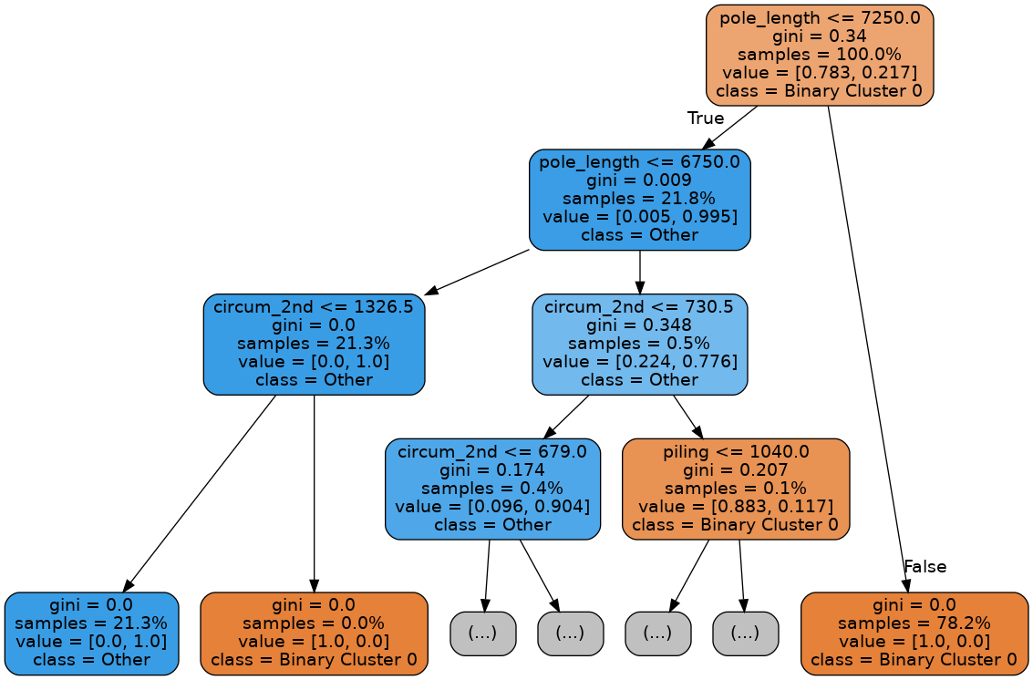
Vonaq Test data Case 2-1 (All colours 4 clusters) Cluster 0

Slide 39
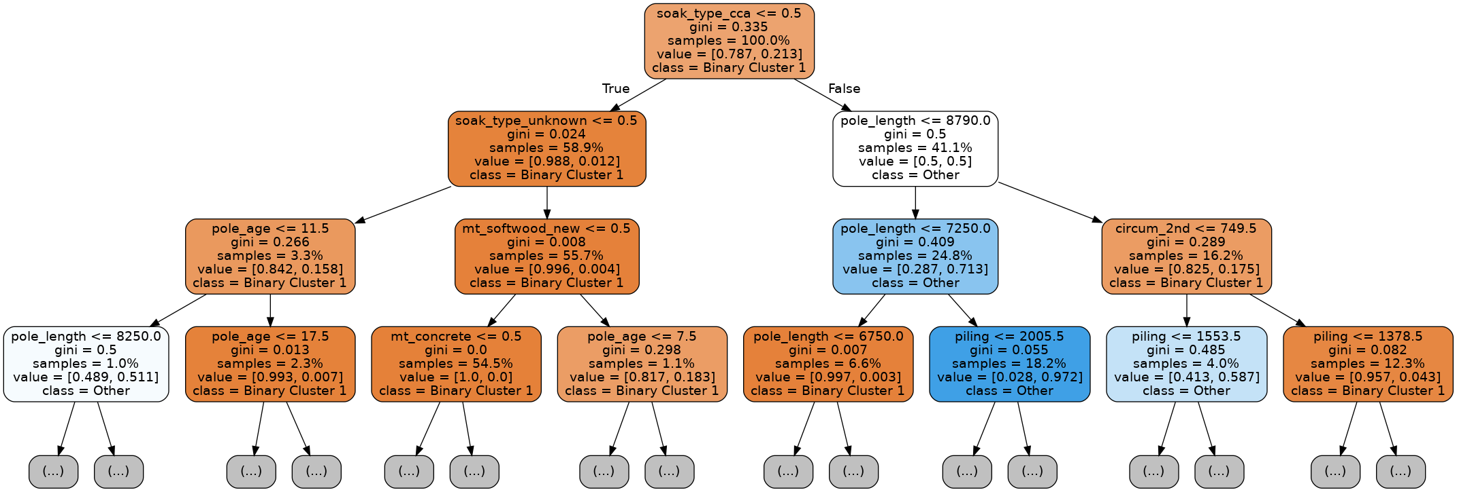
Vonaq Test data Case 2-1 (All colours 4 clusters) Cluster 1

Slide 40
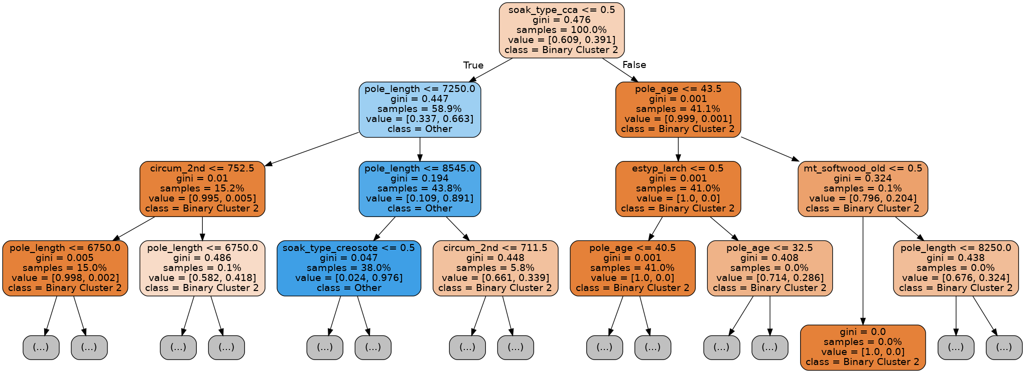
Vonaq Test Case 2-1 data (All colours 4 clusters) Cluster 2

Slide 41
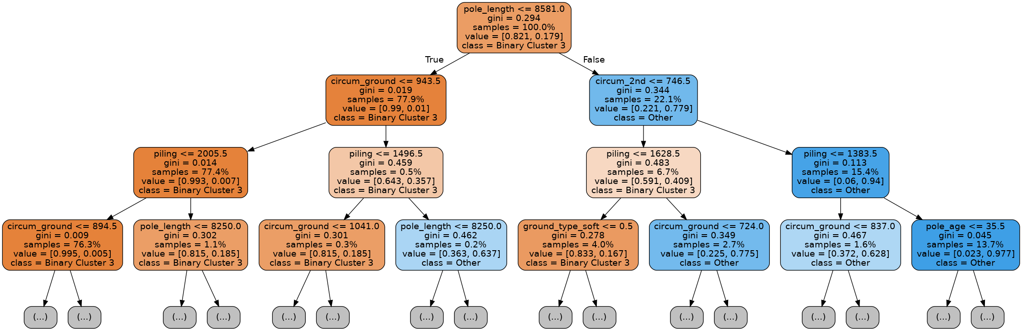
Vonaq Test Case 2-1 data (All colours 4 clusters) Cluster 3

Slide 42
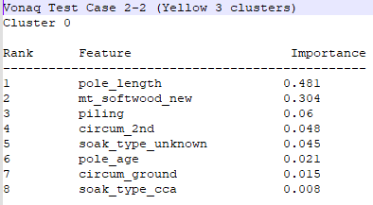
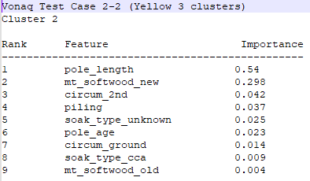
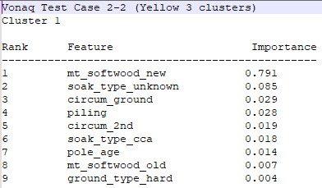
Vonaq Test data Case 2-2 (Red + Yellow 3 clusters) most important features distinguishing each cluster

Slide 43

Vonaq Test data Case 2-3 (Red + Yellow 4 clusters) Cluster 0

Slide 44

Vonaq Test data Case 2-3 (Red + Yellow 4 clusters) Cluster 1

Slide 45

Vonaq Test data Case 2-3 (Red + Yellow 4 clusters) Cluster 2

Slide 46




Vonaq Test data Case 2-4 (Red + Yellow 4 clusters) most important features distinguishing each cluster

Slide 47

Vonaq Test data Case 2-4 (Red + Yellow 4 clusters) Cluster 0

Slide 48

Vonaq Test data Case 2-4 (Red + Yellow 4 clusters) Cluster 1

Slide 49

Vonaq Test data Case 2-4 (Red + Yellow 4 clusters) Cluster 2

Slide 50

Vonaq Test data Case 2-4 (Red + Yellow 4 clusters) Cluster 3

Slide 51




Vonaq Test data Case 2-5 (Green & Yellow 4 clusters) most important features distinguishing each cluster

Slide 52

Vonaq Test data Case 2-5 (Green & Yellow 4 clusters) Cluster 0

Slide 53

Vonaq Test data Case 2-5 (Green & Yellow 4 clusters) Cluster 1

Slide 54

Vonaq Test data Case 2-5 (Green & Yellow 4 clusters) Cluster 2

Slide 55

Vonaq Test data Case 2-5 (Green & Yellow 4 clusters) Cluster 3

Slide 56
Thanks!
Questions?

Slide 57
Appendix
Good things

